Slide 1
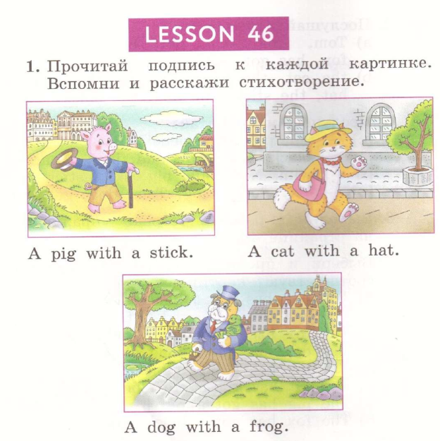

Student’s Book p. 90
A … went to town to buy a …
What? A … with a …?
A … for a …?
Who ever saw a … with a …?

Slide 2
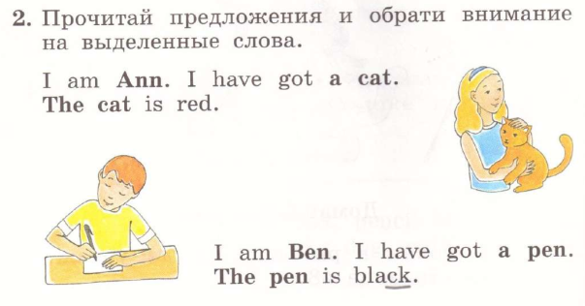
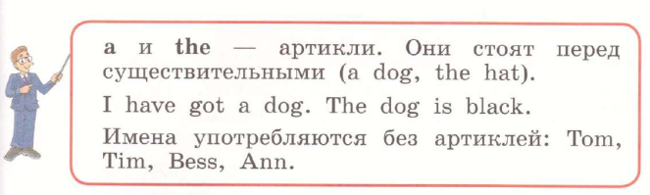

Slide 3


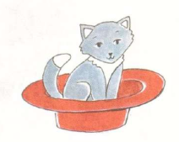
red

Slide 4

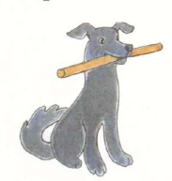
stick
stick
stick
brown

Slide 5

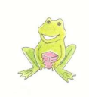
green
frog
box
box
is
pink

Slide 6






Slide 7
